Slide 1


AirAware: Smart Air Quality System
PRESENTED BY [YOUR NAME]

Slide 2
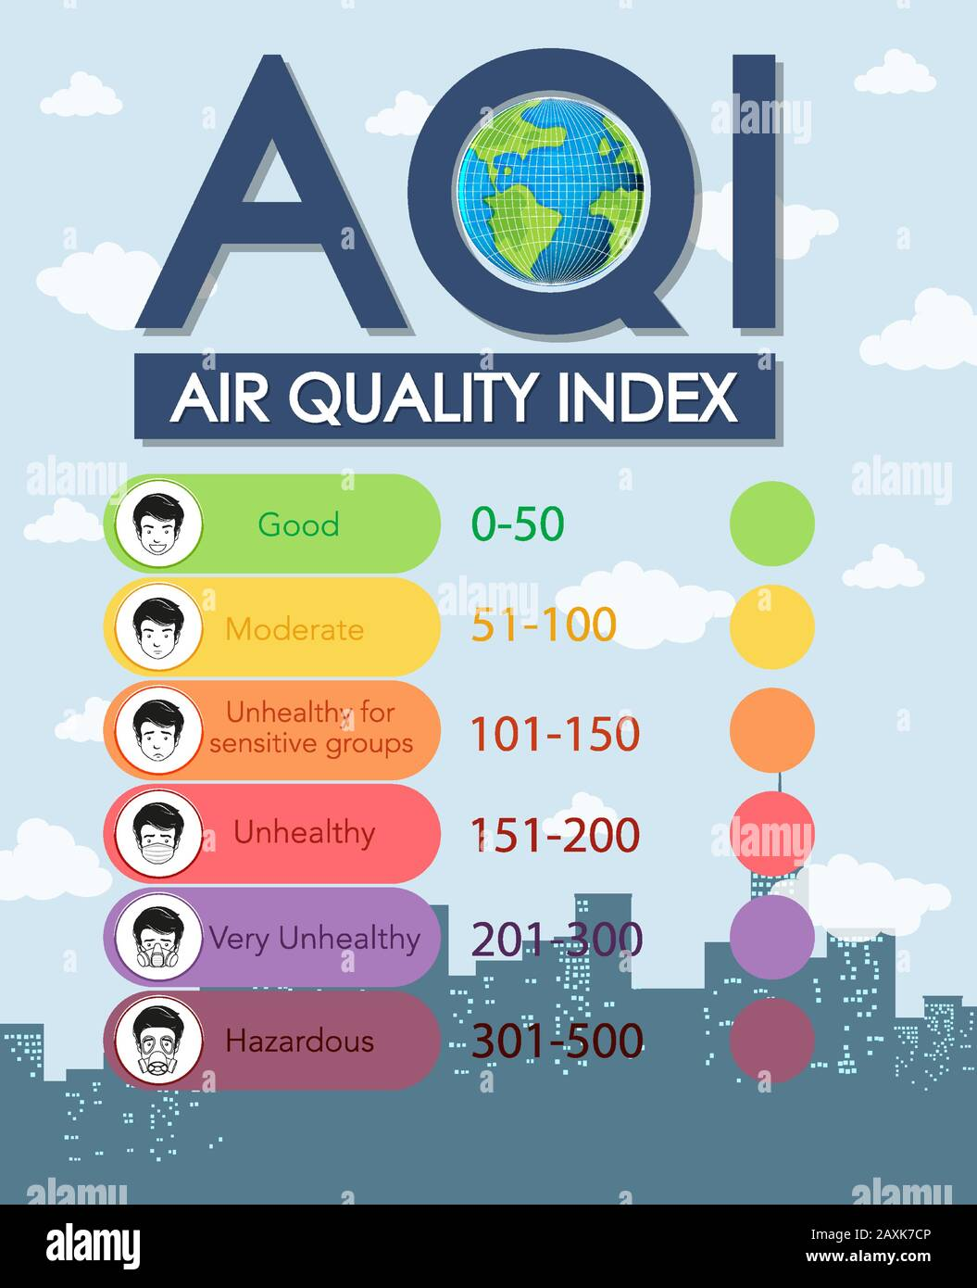
Understanding Air Quality Index (AQI)
IMPORTANCE OF AQI
The Air Quality Index (AQI) measures air pollution levels. It helps the public understand air quality conditions. The scale ranges from 0 to 500, indicating the potential health impacts based on pollutant concentration, guiding individuals on outdoor activities.

Slide 3
Factors Influencing AQI
01
PM2.5/PM10
PM2.5 is finer and more harmful; PM10 is larger. Both lower air quality and harm breathing.
02
CO2
Carbon monoxide (CO) is a colorless gas produced by incomplete combustion of fossil fuels, impacting air quality and leading to serious health issues when inhaled.
03
NO2
Nitrogen dioxide (NO2) results from vehicle emissions and industrial activities. It can aggravate respiratory diseases and is a key contributor to smog formation, impacting air quality significantly.
04
SO2
Sulfur dioxide (SO2) is emitted from industrial processes and burning fossil fuels; it contributes to acid rain and respiratory problems, affecting both human health and the environment.

Slide 4
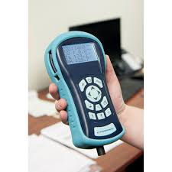
Measurement Techniques for Air Pollutants
UNDERSTANDING HOW POLLUTANTS ARE DETECTED
Various advanced measurement techniques are employed to accurately assess air pollutants, ensuring reliable data for air quality analysis and forecasting.

Slide 5




Agencies Providing AQI
CPCB
SAFAR
APPS
The Central Pollution Control Board (CPCB) is responsible for monitoring air quality across India and provides essential data on pollution levels.
The System of Air Quality and Weather Forecasting and Research (SAFAR) offers real-time air quality information and forecasts for various cities.
Applications like AQI India, IQAir, and AirVisual provide accessible air quality information, helping individuals make informed decisions about their health.

Slide 6



Major Contributors to Air Pollution
SOLID FUEL
DIESEL GENERATORS
CONSTRUCTION DUST
Burning solid fuels releases harmful particulates.
Diesel engines emit significant air pollutants regularly.
Dust from construction sites impacts local air quality.

Slide 7

Impact of Air Pollution
HEALTH AND ENVIRONMENTAL CONSEQUENCES
Causes respiratory diseases and asthma attacks
Increases risk of heart-related issues
Contributes to higher cancer rates
Accelerates global warming and climate change
Leads to acid rain affecting ecosystems
Reduces visibility and air quality

Slide 8
Solutions and Prevention Methods
01
AIR PURIFIERS
Air purifiers can significantly reduce indoor air pollution by filtering out harmful particles, allergens, and chemicals, creating a healthier home environment for everyone.
02
GREEN ENERGY
Transitioning to green energy sources, such as solar and wind, helps decrease reliance on fossil fuels, thereby reducing greenhouse gas emissions and improving air quality.
03
CLEAN FUELS
Utilizing clean cooking fuels like LPG or biofuels can minimize harmful emissions from traditional cooking methods, contributing to better air quality and safer homes.

Slide 9
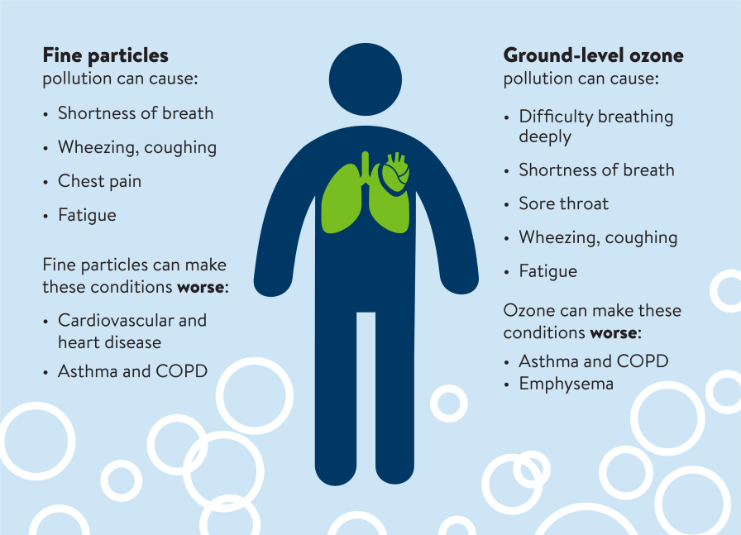
Impact and Importance of AirAware
ENHANCING AIR QUALITY MONITORING
AirAware provides critical forecasting for dangerous AQI levels, sending alerts to the public. It supports informed decision-making for stakeholders, utilizes advanced ML modeling, and features visualization dashboards for real-time data interpretation and user engagement.

Slide 10
Tech Stack Overview
01
PYTHON
Python is a versatile programming language widely used in data analysis, machine learning, and application development, offering extensive libraries for various tasks including data manipulation and visualization.
02
STREAMLIT
Streamlit is an open-source app framework specifically for machine learning and data science projects, allowing developers to create interactive web applications easily and quickly, enhancing user engagement.
03
MACHINE LEARNING
Machine learning trains and deploys the best-performing time-series models (Prophet, LSTM, XGBoost) to generate reliable AQI forecasts

Slide 11
Project Timeline
DATA INPUT
PREPROCESSING
ML MODELS
Collect initial air quality data for analysis.
Clean and prepare data for model training.
Apply machine learning techniques for predictions.

Slide 12

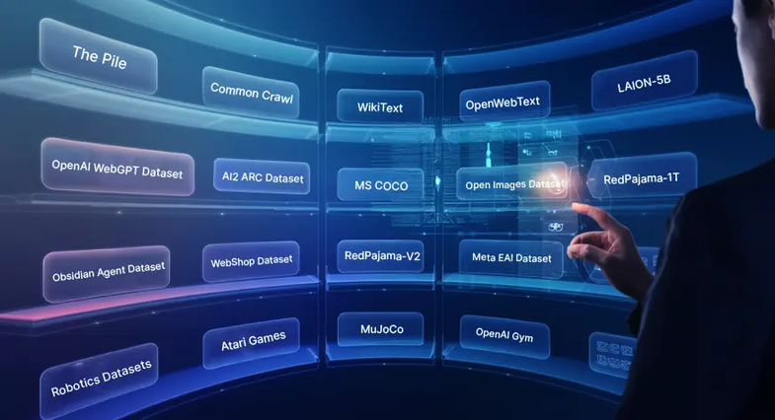


Steps to Run the Project
INSTALL
PLACE DATASETS
Download and install necessary packages.
Upload datasets in the required folder.
ADMIN MODE
USER MODE
Access mode for training ML models.
Mode for making predictions on data.

Slide 13
Future Enhancements of AirAware
01
IOT INTEGRATION
Integrating IoT sensors will enable real-time data collection and monitoring, enhancing the accuracy of air quality predictions and allowing for timely alerts to pollution spikes.
02
INTEGRATION WITH WEATHER APIS
Integration with weather APIs enables the system to incorporate real-time meteorological data such as temperature, humidity, and wind speed. This enhances AQI prediction accuracy by capturing environmental factors that directly influence pollutant dispersion and concentration.
03
CLOUD DEPLOYMENT
Utilizing cloud infrastructure will provide scalability and flexibility, allowing for broader data access, improved collaboration, and enhanced performance of the AirAware system across diverse regions.

Slide 14


Thank You for Your Attention
EMAIL CONTACT
codingshiven15@gmail.com
GITHUB LINK
https://github.com/ShivenPoojary01/Infosys_AirQuality_Oct-Nov_2025_Shiven
PROJECT LINK (DASHBOARD 4)
https://airawareshiven158.streamlit.app/?embed_options=light_theme

